Slide 1
back to the future of property classifieds + marketplaces
Madrid October 26th, 2022

Slide 2
european internet ventures.
who I am
Malcolm Myers
15 years of marketplaces
former head of m&a at Naspers former m&a advisor to Scout24
CEO of eiv
what we do
advisory firm dedicated to
online classifieds + marketplaces
m&a
capital raising
where we work

Slide 3
some of our transactions.
real estate
automotive
jobs
horizontals
note: includes selective capital raising, M&A sell side and CDD mandates

Slide 4
contents.
1. what’s been happening?.
2. which models will win?
3. options for portals.
4. back to the future-.
(what should portals do now?).
Notes:
Less about unveiling companies and business models you have not heard of after 2 days’ of conference
Rather by reviewing the emerging challenger models, seek to identify which models might displace classifieds by better solving the the problem of buying and selling large ticket items
focus on car and real estate

Slide 5
what’s been happening?
1
5
Notes:
So not only is going around the transactions unlikely to realize the full potential of today’s classifieds leaders
In addition, many new models are being introduced which threaten to disrupt the core classifieds listings business

Slide 6
today, classifieds valuations are roughly where they were when we last met at PPW Madrid.
$M
MARKET CAP_ REAL ESTATE CLASSIFIEDS
CHANGE
12/19 – 10/22
EBITDA MULTIPLES
2019 2020
-2.5%
27.4
22.6
-36.4%
21.1
15.2
-14.5%
14.0
16.6
n/a
n/a
19.0
source: REFINITIV 1st June 2022 note: charts depict market cap in MUSD; years refers to year end

Slide 7
the transactional platforms generated much investor excitement… and then lost it.
$M
MARKET CAP_ iBUYER + TEB
CHANGE
-61%
-36.4%
-14.5%
n/a
source:
source: REFINITIV 1st June 2022 note: charts depict market cap in MUSD; years refers to year end

Slide 8
zillow went from classifieds to iBuyer… and back.
MARKET CAP
$M
zillow offers exit announced
so was the market wrong to get so excited about pure transaction platforms?
source: REFINITIV 1st June 2022 note: charts depict market cap in MUSD; years refers to year end

Slide 9
the core classifieds process remains largely broken.
INFORM COMPARE TRANSACT PAYMENT DELIVERY WARRANTY RETURNS
buying a home
on classifieds
buying a smartphone
on Amazon
off platform
source: EIV Analysis

Slide 10
what can we learn from the automotive segment? (1/3)
transactional models from non-classifieds players
C2B
B2C
instant cash offer from platform
iDealer
direct offers from selected dealers
10
source: EIV Analysis; note: examples are illustrative, not exhaustive

Slide 11
what can we learn from the automotive segment? (2/3)
transactional models from non-classifieds players
transactional models adopted by classifieds players
C2B
B2C
C2B
B2C
instant cash offer from platform
iDealer
instant cash offer from platform
commission sharing
classifieds partners B2B
classifieds buys C2B
e-commerce overlay to digitally enable dealer stock
direct offers from selected dealers
direct offers from selected dealers
in house iDealer
iDealer buys classifieds
11
source: EIV Analysis; note: examples are illustrative, not exhaustive

Slide 12
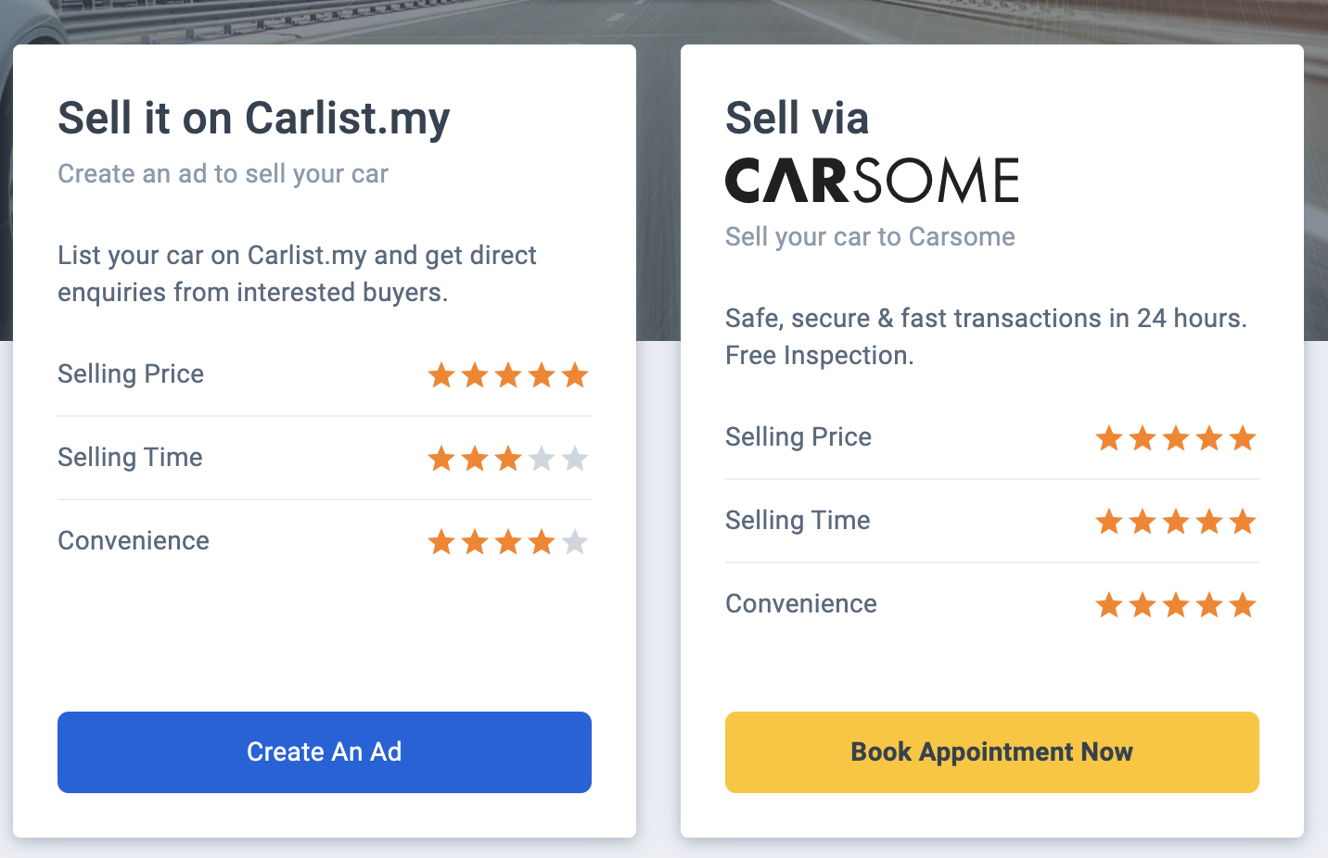
what can we learn from the automotive segment? (3/3)
many classifieds players have used M&A to accelerate business transition e.g. OLX acquiring FCG to enter C2B transactions, or iCarAsia (classifieds) being sold to Carsome (iDealer) ; M&A can provide expertise and rapid route to scale
models which offer a role for traditional dealers, often scale the fastest and with lower capital needs e.g. AutoScout24 smyle
classifieds brands can be used to co-brand iDealers (AutoScout24 smyle)
it is possible for classifieds platforms to also become dealers, without alienating subscription paying dealer clients
12
source: EIV Analysis

Slide 13
real estate classifieds players are responding more slowly.
transactional challenger models from non-classifieds players
transactional models adopted by classifieds players
C2B
B2C
C2B
B2C
instant cash offer from platform
TEB
instant cash offer from platform
commission sharing
e-commerce overlay to digitally enable dealer stock
transaction digitization services from classifieds emerging in rentals space
direct offers from selected dealers
classifieds players sell vendor leads to preferred agents; -
Zillow refers sellers, wanting a fast cash sale, to Opendoor
direct cash offers to sellers
from vetted dealers
n/a
in house TEB
13
source: EIV Analysis; note: examples are illustrative, not exhaustive

Slide 14
which models will win?
2
14
Notes:
So not only is going around the transactions unlikely to realize the full potential of today’s classifieds leaders
In addition, many new models are being introduced which threaten to disrupt the core classifieds listings business

Slide 15
most real estate portals rely heavily on subscription revenues from long tail real estate agents.
> 40 21-40 11-20 ≤ 10
65% of revenues from real estate agencies generating fewer than 20 sales per year
UNIT SALES / YEAR
SHARE OF REVENUE
17%
18%
32%
33%
dependence upon the long tail of small / mid sized intermediaries looks highly risky
15
source: the bar chart reflects the revenue mix in 2020 of a typical European real estate classifieds player

Slide 16
much of what real estate agents do today can be
done better, faster and cheaper with software + data
preparation
buyer management
negotiation + closing
property valuation
description & photos
virtual tour option
physical FOR SALE sign
source buyers
qualify buyers
book viewings
conduct viewings
follow up with buyers
negotiate with buyers
offer acceptance
project manage transaction
provide document templates
offer packaged legal support
verify buyer financing
arrange notary and signing
ongoing advice and support
software + data
traditional real estate agents can excel at conducting viewings, negotiating with buyers, and in providing ongoing advice to sellers
TEBs, who can match on these 3 services, while industrializing with software and data the rest, can offer superior service at far more attractive unit economics
16
source: EIV Analysis

Slide 17
which means that over time, the real estate agency landscape is likely to see rapid consolidation into a small number of large TEBs.
born TEB
scaled + tech-enabled
adapt or fade away
?
long tail of small agents
the internet has brought comparable disruptions to other “high street” services including retail, banking, travel agents, and banks, all who have seen the emergence of powerful online-only businesses
while some “Born TEBs” will fail, the best will become “super brokers” and aim to reduce dependence on portals both for vendor and buyer leads; Redfin now generates an impressive 25% of the traffic of Zillow
A harsher macro environment, with higher interest rates and lower transaction volumes is likely to accelerate this trend
17
source: EIV Analysis

Slide 18
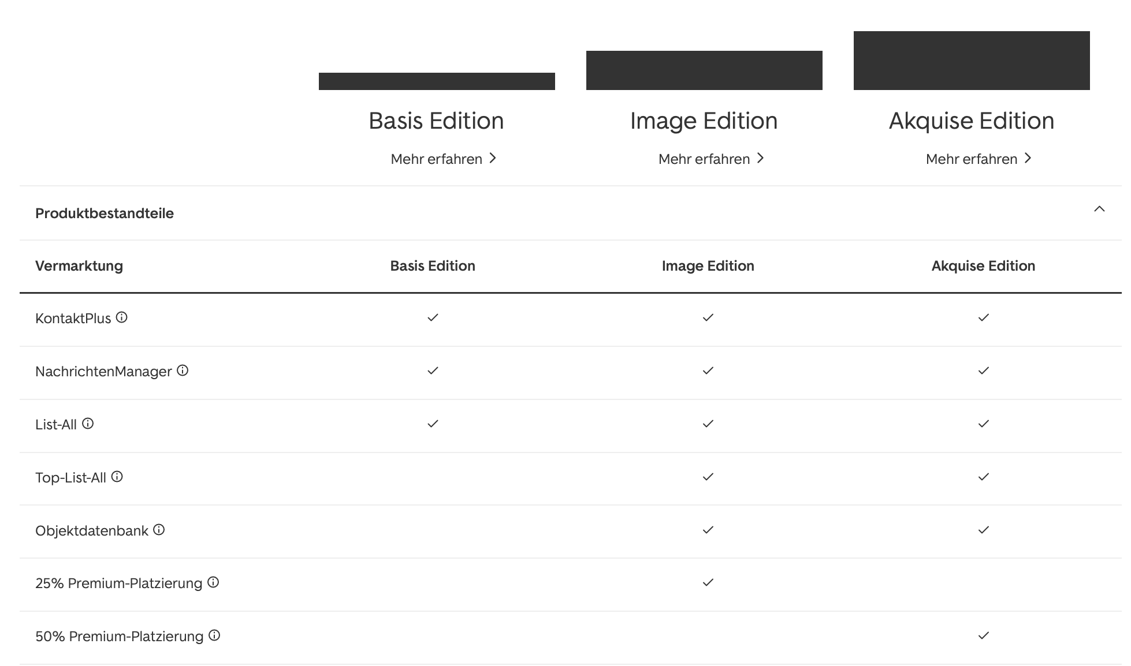
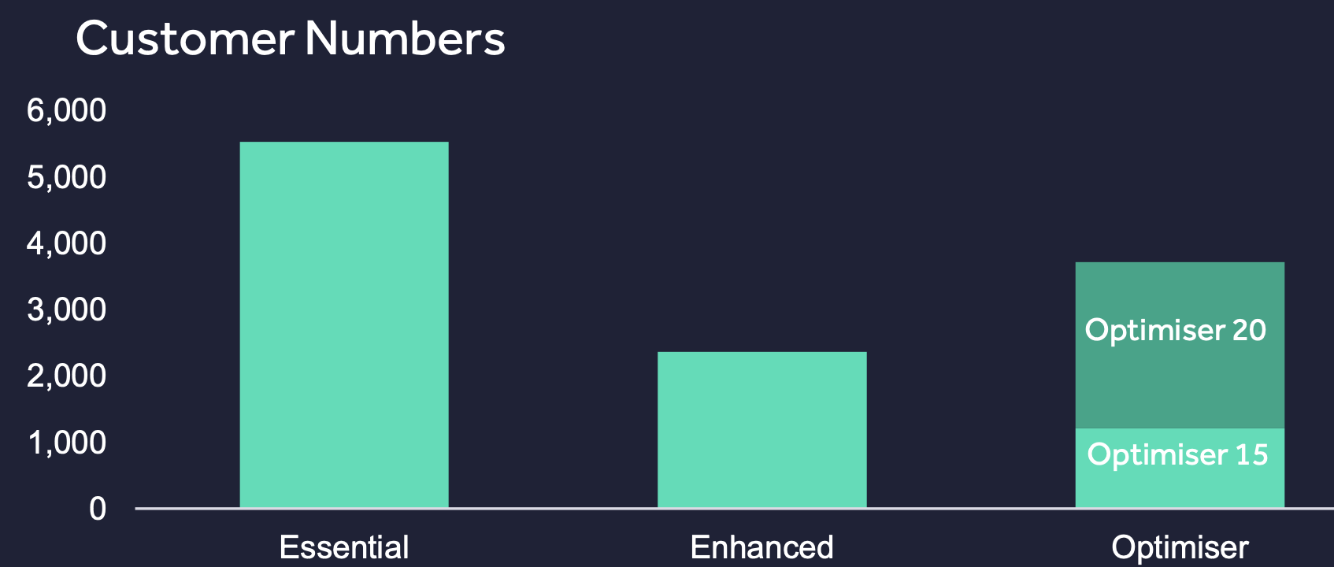
today’s subscription models will fail to capture
the full marketplace opportunity.
traditionally seen as the best model to ensure a dependable income stream
scope to upsell agents to products delivering higher visibility and more market insights
package pricing typically depends upon…
# listings
# premium slots
# agents (seats/offices)
fails to align lead value and price paid
discourages fast and accurate matching
provides limited incentive to portals to deliver seller leads
future revenue growth will require…
value-based leads pricing
progressive introduction of commission sharing on seller and buyer leads
source: company websites

Slide 19
zillow is transitioning classifieds into a performance-based + increasingly commission-based model.
revenue per customer transaction
$4,100
both Zillow and Rightmove’s core business is providing buyer and seller leads; but by moving to performance-based revenue models, Zillow has greater scope to increase revenue per home listed / sold
Rightmove agents pay according to package features, and generates ca. £275 per unique for sale home it lists
Zillow Premier Agents either pay according to segment specific “share of voice” (c.a. PPL), or share final buy/sale commission (Zillow Flex)
$4,100 equates to 1.1% of the national average 2021 home price
Zillow targets $5,200 per transaction and 0.73M or 6% transaction market share
# customer transactions
0.36M
total transactions revenue
$1,500M
other services revenue
$609M
total revenue
$2,109M
# market transactions
6.1M
avg revenue per advertiser (ARPA/yr.)
£22,591
# subscribing agencies + developers
18,969
other services revenue
£24M
total revenue
£305M
# market transactions
1.5M
source: 2021 company accounts
note: customer transactions are home sales where final transaction involved a Zillow Premier Agent on the buy or sell side; a Zillow home loan or closing services product; attribution looks low

Slide 20
inventory shortages during the pandemic have accelerated focus on generating vendor leads.
strategic importance
pre-pandemic, most classifieds players had been focusing on delivering buyer leads (MA being the exception)
potential sellers drawn to website via AVM tool allowing them to value their home for free
service forwards mandate leads to agents most qualified to assist potential seller
model is moving from agents subscribing for vendor leads to commission sharing on vendor leads resulting in a sale (rightmove is still using the subscription model)
Zillow sees $100B revenue potential (SAM) from real estate transaction referral fees, or 1/3 of the total US buyer and seller agent pot
…and has ended the taboo on commission sharing in Europe and US
source Zillow Investor Presentation February 2022 p.17:

Slide 21
iBuyers have expanded into broader fintech-powered real estate platforms.
NCO
yes
yes
yes
yes
BBYS
yes
yes
yes
yes
partner with agents
yes
no
yes
no
iBuy
core
core
last resort
last resort
home prep + manage sale
yes when iBuyer
yes
yes
yes
win-win-win
home buyer is more likely to make a winning bid and enjoys the convenience of moving into their new home while the iBuyer takes care of prepping and selling their old home; iBuyer can raise transaction velocity without taking the same financial risk as with outright purchase; agents differentiate themselves by making these products available to their vendor or buyer clients thereby winning more buy/sell mandates and reducing time to close
Non-Contingent Offers (NCO) are financing arrangements allowing buyers to become 100% cash buyers when they bid for a new home, e.g. in event a mortgage approval came up too late or too short
Buy Before You Sell (BBYS) uncouples the purchase of a new home from the sale of the current home; it makes the offer on the new home an all-cash offer, while also allowing the seller to move into their new home while the iBuyer takes care of selling their old home
source: company websites

Slide 22
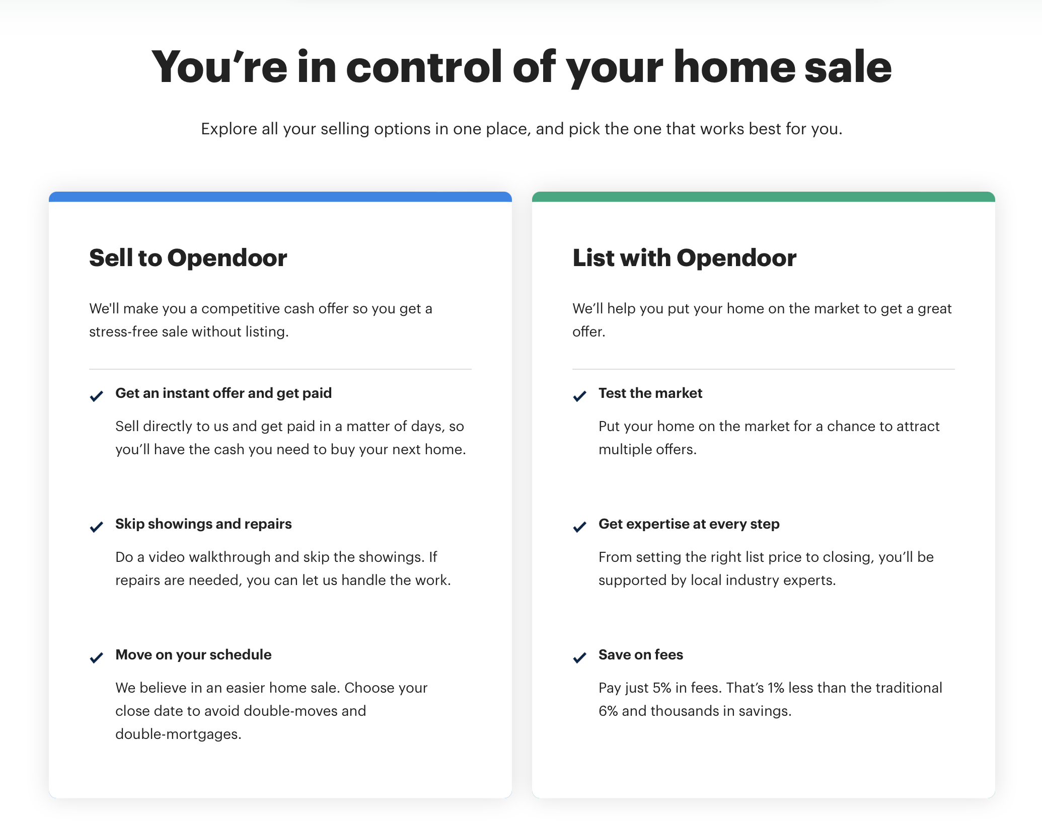
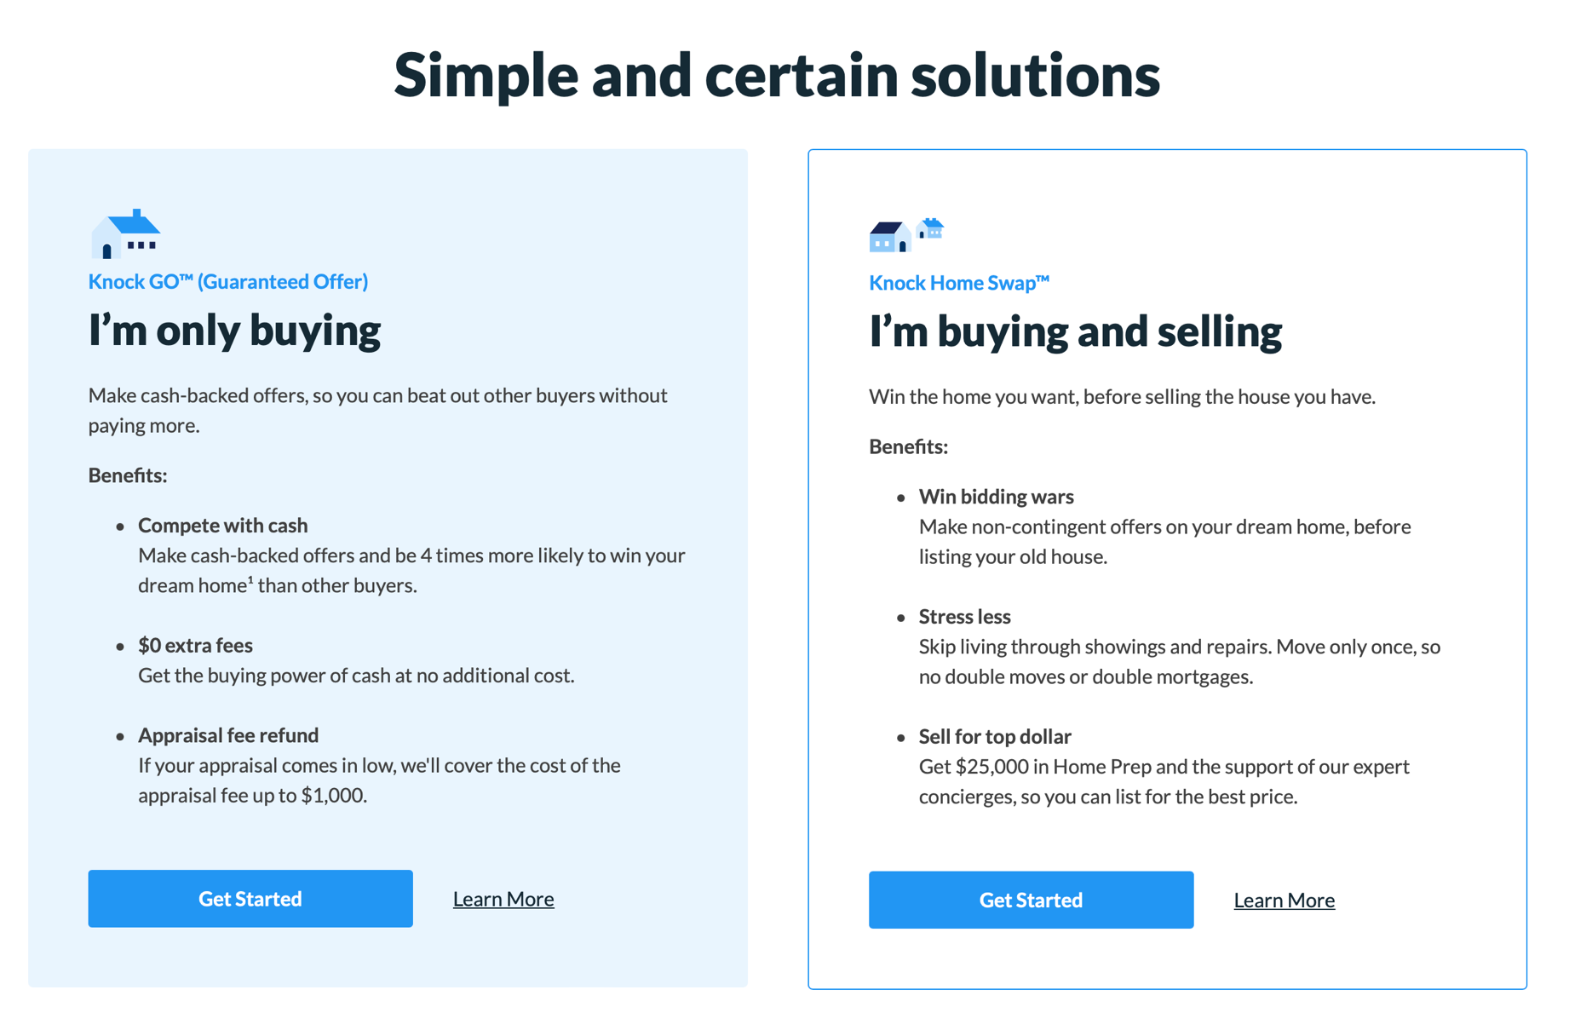
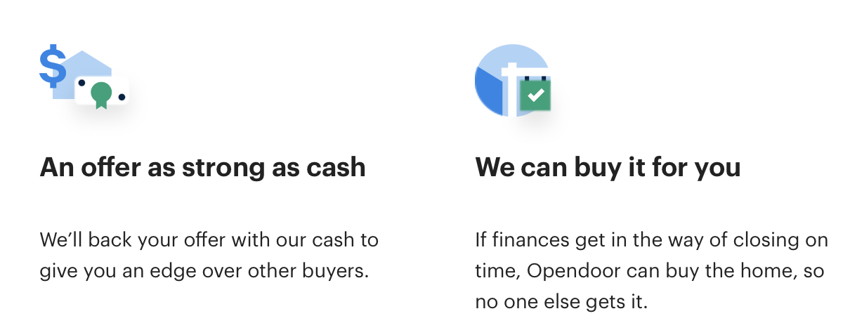
the most profitable iBuyers are likely to be those who
generate the most seller leads, while actually buying the
least number of homes.
22
source: company websites

Slide 23
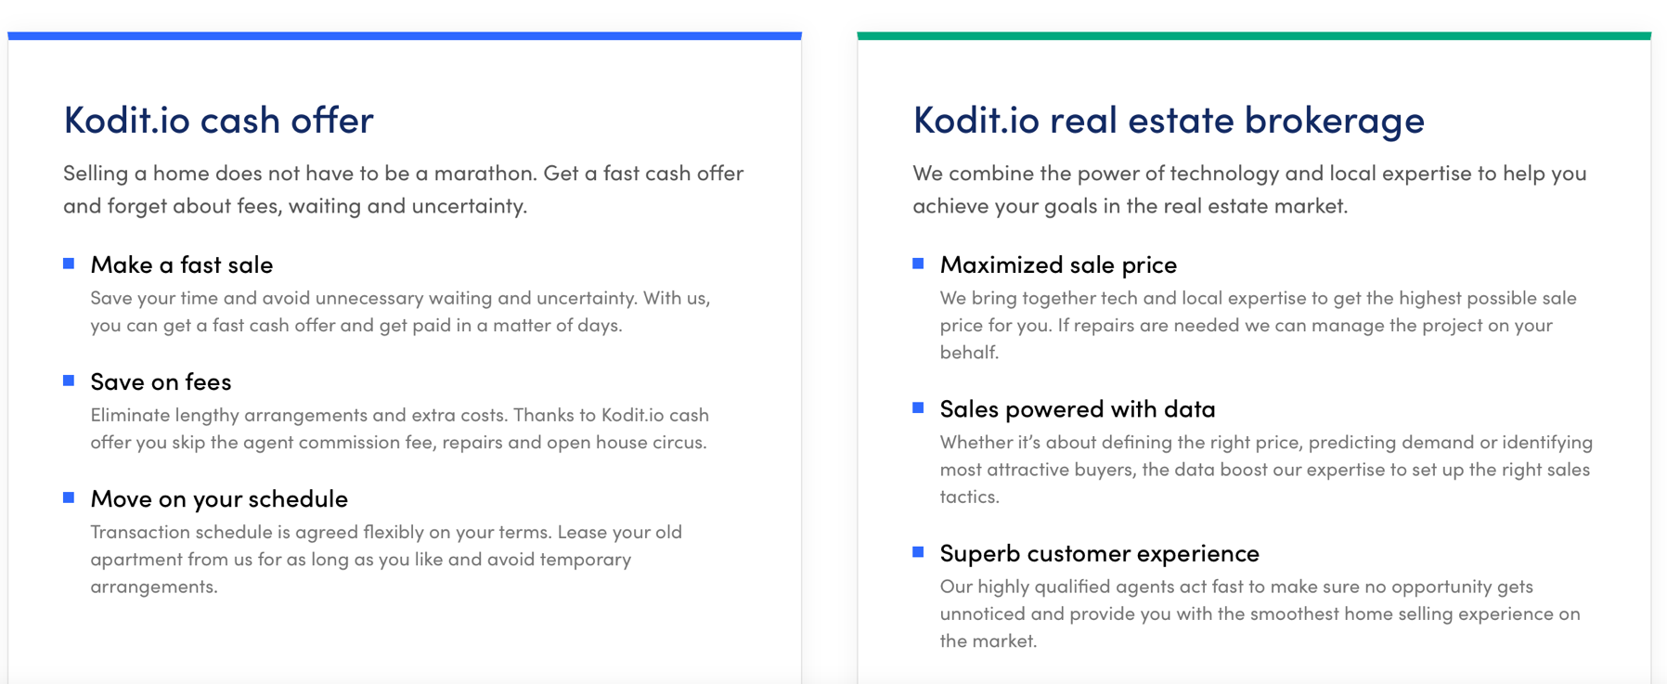
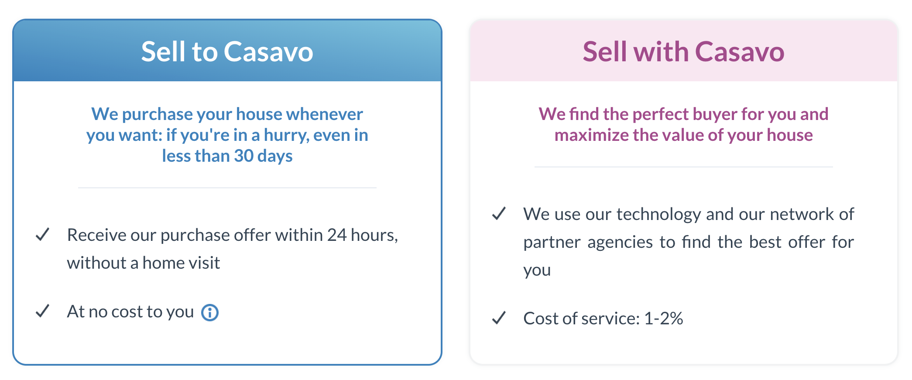
europe’s iBuyers are partnering with agents to access
more capital-efficient commission streams.
europe’s iBuyers trail US players in launching BBYS services; local commission structures and regulations make this harder, but not impossible
expanding the number of potential sales by partnering with agents, without putting more capital at risk, provides additional avenues for growth
Casavo’s recent acquisition of French TEB Proprioo, confirms this trend
23
source: company websites

Slide 24
we are now seeing the emergence of fully transactional online marketplaces.
initially an iBuyer, Loft is now a real estate marketplace
brokers currently list 13k properties for free in return for Loft commission share
demand generated by Loft’s brand, SEO and digital marketing plus buy side brokers
backers include a16z and valued at $2.9B 6/2021
started as a managed rentals platform, developed collaborative model with agents, giving them commission share in return for inventory
runs C2C property sales via direct listings from owners and collaborative model with independent agents
valued at $5.1B in 8/2021
started as a mortgage platform
has expanded to become a digital platform for home sales
partners with agents who bring inventory
Huspy gets a commission share, and a shot at selling more mortgages
Raised $32M Series A June 2022
started as an auction platform to sell reposessed bank properties, with demand gen via digital marketing and agents
has launched a C2C business
sources properties for sale from sell-side agents, in house telesales and own digital channels
raised $7M to date
it is in emerging markets, with less-developed real estate agency groups, that we see the most advanced transactional real estate marketplaces
source: company websites

Slide 25
options for portals.
3
25
Notes:
So not only is going around the transactions unlikely to realize the full potential of today’s classifieds leaders
In addition, many new models are being introduced which threaten to disrupt the core classifieds listings business

Slide 26
the current market offers classifieds businesses the most extreme set of opportunities + threats we have seen so far.
threats
opportunities
MAJOR
falling transaction volumes
long tail agents disappear
TEBs consolidate market share
younger buyers expect e-commerce experience
developers going direct
co-Living / LaaS lowers #transactions
buy-to-let marketplaces take transaction volume away from classifieds
build/buy in house TEB
offer BBYS products
provide vendor leads on a revenue share basis
migrate pricing from subscriptions to PPL / PPS
provide open transactional infrastructure for selective agency partners
MINOR
26
source: EIV Analysis

Slide 27
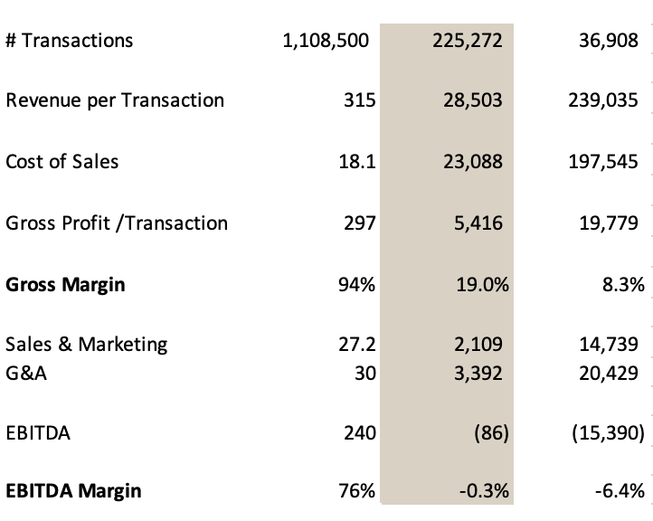
in terms of profitability, a dominant classifieds portal is hard to beat.
classifieds
TEB
iBuyer
(in USD)
the classifieds advertising model is able to generate EBITDA margins in excess of 75%; it is able to monetize 75% or more of all home sales (if these are listed on its portal)
on the flip side, monetization in tems of % of brokerage commission captured (about 8% in the case of Rightmove) or % of value of object sold is arguably still low
TEB and possibly iBuyer, at a certain scale are likely to be delivering materially more EBITDA per sale
27
source: Company Accounts, EIV Analysis note: data refers to Jan-Dec 2021 GBP concerted to USD at 1.15; rightmove CoS, S&M, G&A splits are estimates; Opendoor # transactions refers to purchases only in 2021

Slide 28
but not every market will produce a REA, rightmove, or Zillow.
HIGH
VERTICAL LEADERS
*
*
.COM.SG
*
*
one vertical dominates
*
.COM
SE ASIA
MALAYSIA
ITALY
RUSSIA
CHINA
SWITZERLAND
MYANMAR
THAILAND
no dominant players
PHILIPPINES
INDONESIA
INDIA
COMPETITIVE MIDDLE
market structure
LOW
AUSTRIA
UKRAINE
one horizontal dominates
HORIZONTAL LEADERS
HIGH
SMALL
MID
LARGE
internet population
source: internetworldstats.com, EIV analysis
note: *dominant vertical and dominant horizontal belong to same group

Slide 29
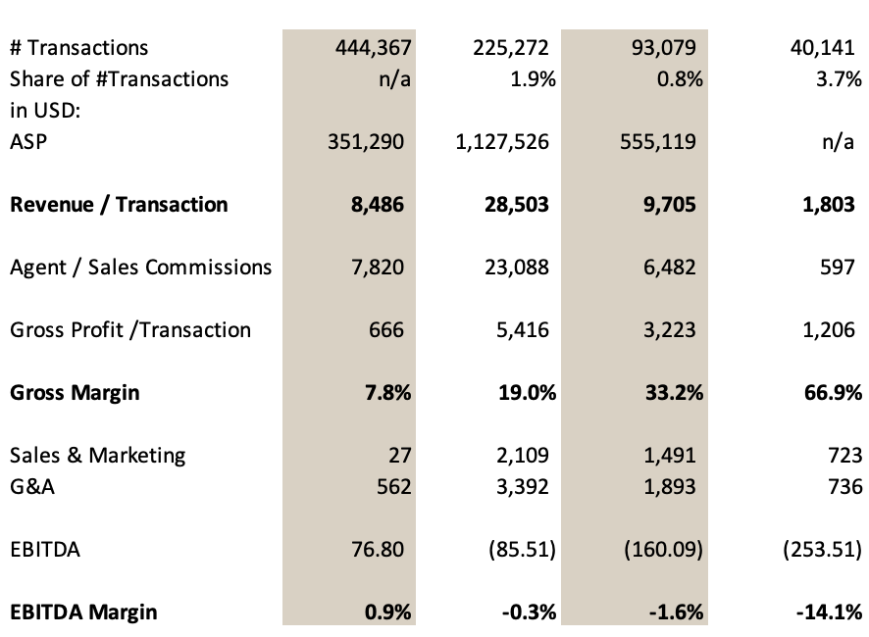
unit economics for TEB’s vary substantially, but clearly aren’t delivering yet.
only exp was profitable in 2021, but only generated $77 per transaction; they have the lowest cost structure amongst peers, but their high commission sharing structure severely limits EBITDA potential
Compass stands out in terms of the average property value and net revenue per transaction, but their 19% gross margin is insufficient to generate positive EBITDA, Compass is trying to lower agent commission share while reducing S&M and G&A
Redfin’s higher gross margins reflect their largely inhouse sale team; again high S&M and G&A are holding them back from profitability – presumably exacerbated by the Redfin Now iBuyer business (which has been eliminated from these calculations)
the highly competitive UK market limits Purplebricks’ revenue per transaction, so that even with a reasonable cost structure, EBITDA margins are still negative
29
source: Company Accounts, EIV Analysis
note: data refers to Jan-Dec 2021 except for Purplebricks, which is 12M to March 2022; Redfin G&A data is pro-rata to RES sales for G&A; GBP concerted to USD at 1.15

Slide 30
for portals, buying a TEB would provide a short cut
to becoming fully transactional.
preparation
buyer management
negotiation + closing
property valuation
description & photos
virtual tour option
physical FOR SALE sign
source buyers
qualify buyers
book viewings
conduct viewings
follow up with buyers
negotiate with buyers
offer acceptance
project manage transaction
provide document templates
offer packaged legal support
verify buyer financing
arrange notary and signing
ongoing advice and support
standalone
TEB
rudimentary AVM
data gaps e.g. in regions
heavy investment in brand
reliant on classifieds for leads
most are well-placed to offer negotiation and closing services
state of the art AVM
more end transaction data
deep, national coverage
portals can access far more seller leads since most buyers are also sellers
massive volume of traffic + high conversion to leads
buyer behaviour on portal provides deep buyer insight + enhanced ability to match buyers to properties
portal can augment lead quality via bots + call center e.g. move timeframe, mortgage status
portals add scale from which to offer a broader range of financing packages
portals can bring the additional resources to fully automate the title transfer and closing workflow
portal +
TEB
30
source: EIV analysis

Slide 31
back to the future.
4
31
Notes:
Let me start by providing some perspective

Slide 32
OCTOBER 2019
options for classifieds_ real estate.
HIGH
build own commissioned sales team for new dev
launch own hybrid agent
TOUGH TO
OWN THE SALE
in markets in the grey quadrant,
(usually with high GDP/cap), classifieds operators will need to focus on building realtor reliance on their leads, market, competitor and customer data; potentially test hybrid agent for specific segments
Performance-based pricing models should help capture more value
in the gold quadrants, operators have the opportunity to build their own sales teams for selling new developments and existing homes via a hybrid agent model, while still supporting dealers with leads and services
focus on leads, intel
+ services for realtors
capture more value
via CPL + CPS pricing
test your own hybrid agent for specific segments
% sales value
by agents
build own commissioned sales team for new dev
launch hybrid agent or full C2C marketplace
build own commissioned sales team for new dev
launch own hybrid agent
EASIEST TO
OWN THE SALE
LOW
professionalism of agency networks
HIGH

Slide 33
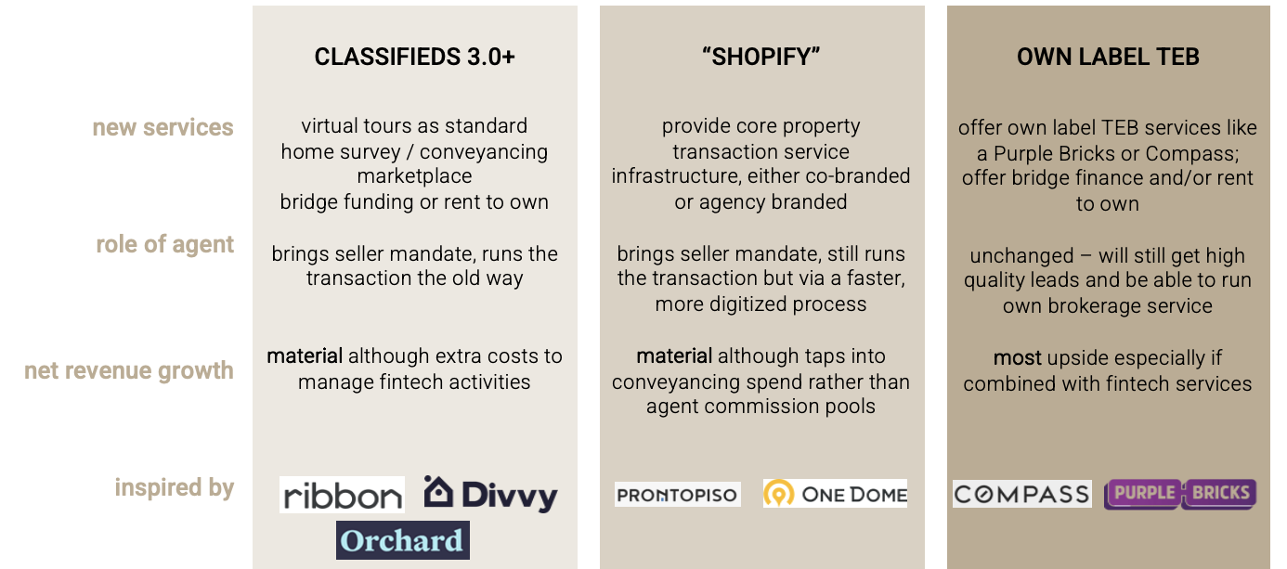
review of previous recommendations.
june 2020
adopted
virtual tours as standard
conveyancing services
“kind of” adopted
no TEB acquisitions yet, but classifieds now accessing commissions on seller mandates & on buy side e.g. Zillow flex
not adopted yet
BBYS fintech play
Shopify model provided by classifieds for home sales, (it is happening for rentals)

Slide 34
conclusion_ real estate.
without developing on-portal transaction capability, classifieds portals will increasingly lose out as long tail agents disappear and well-funded TEBs consolidate share
by proactively embracing the transactional opportunity, classifieds portals can build stronger businesses, delivering higher satisfaction from home buyers and sellers alike, due to the inherent benefits of integrating classifieds with on- platform transactional capabilities; revenue sharing on seller leads is a great first step
Quinto Andar / Loft /Tapu.com show how in less structured markets, collaborative transactional businesses can be agent inclusive
In western markets, with high market concentration from large brokerage networks, providing chain-breaking BBYS products offers a win-win formula for classifieds businesses to raise revenue/transaction while helping agents generate commissions faster

Slide 35
thank you
Malcolm Myers Founder & CEO // European Internet Ventures
mm@europeaninternetventures.com | malcolmmyers on LinkedIn

